Slide 1

User Guide
Version 1.0
Author : Venkata Kishore Vedam

Slide 2
Topics
Employee & User Management
Master Data Setups
Transactions

Slide 3

Employee and User Management
Manage Designations
Employee Management
User Management
Access Management

Slide 4
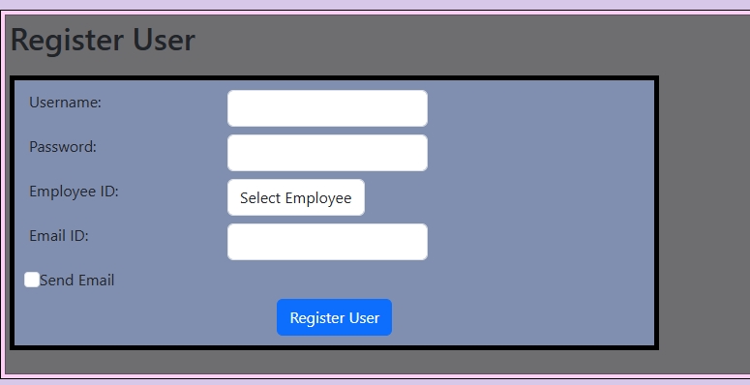
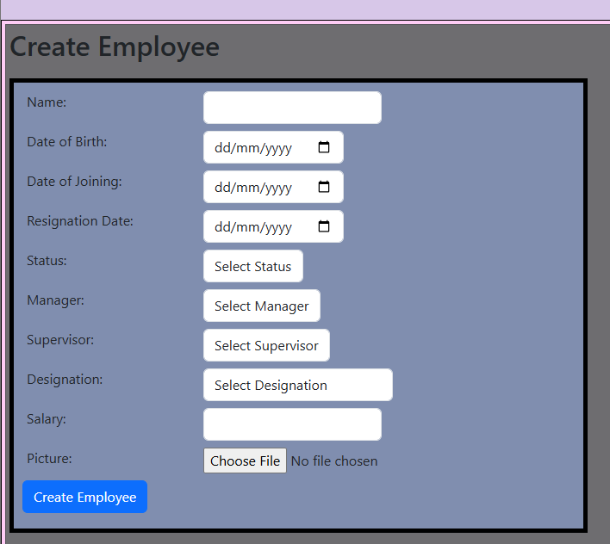
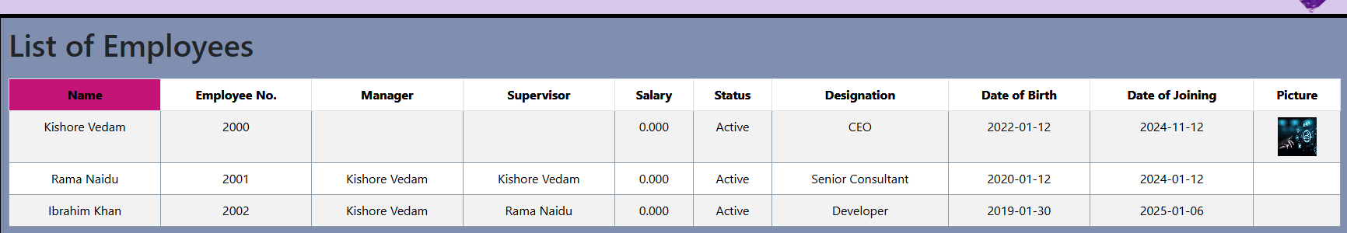
User and Employee Management
Each user is linked to an employee, but this association does not apply to super users.
Create Designations
Navigation : Modules > Admin & setup > Employee > Designations
Create Employee
Navigation : Modules > Admin & setup > Employee > Create Employee
Create User
Navigation : Modules > Admin & setup > User and Accesses

Slide 5
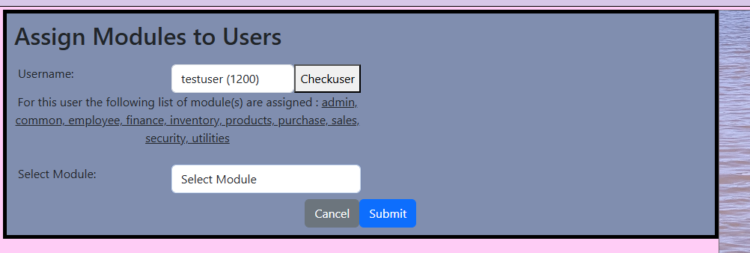
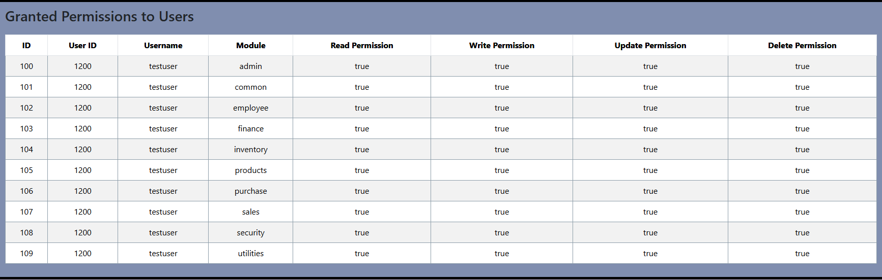
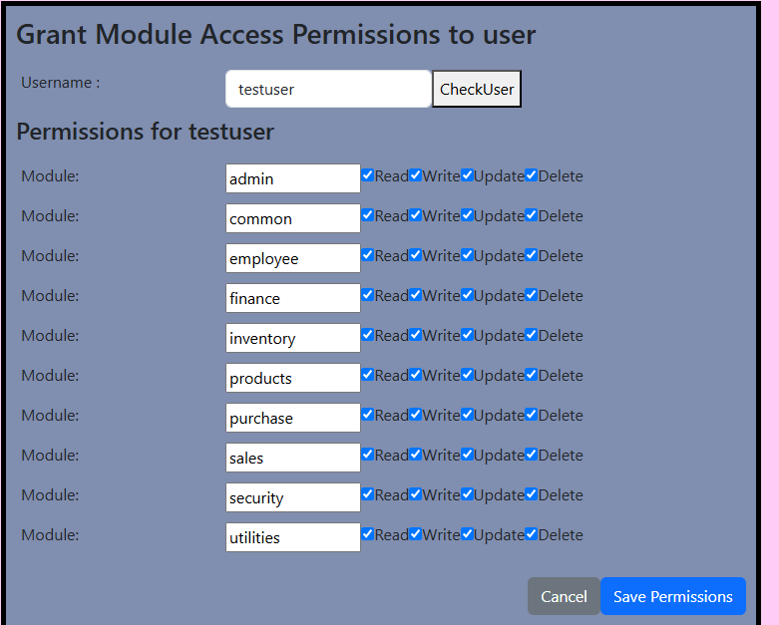
Access management
User needs Accesses to perform transactions in the modules
Assign Modules to User
Navigation : Modules > Admin & setup > User & Accesses > Permissions > Assign modules
Grant Accesses to Modules
Navigation : Modules > Admin & setup > User & Accesses > Permissions > Grant Accesses
View user accesses
Navigation : Modules > Admin & setup > User & Accesses > Permissions >List User Accesses

Slide 6
Master Data & Setups -1
Manage Unit of Measures
Manage Currencies
Manage Tax Codes
Manage Exchange Rates
Manage Accounts

Slide 7
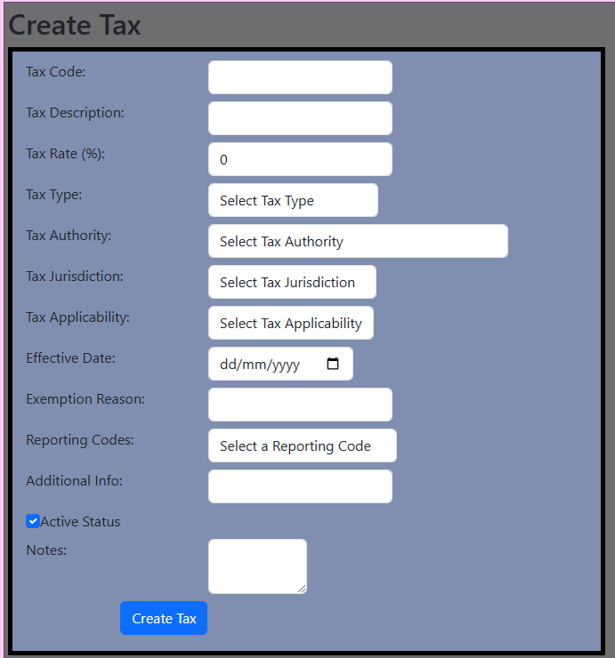
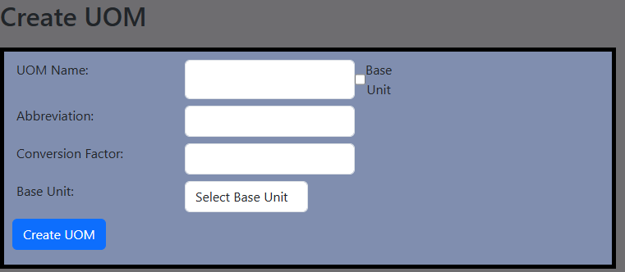
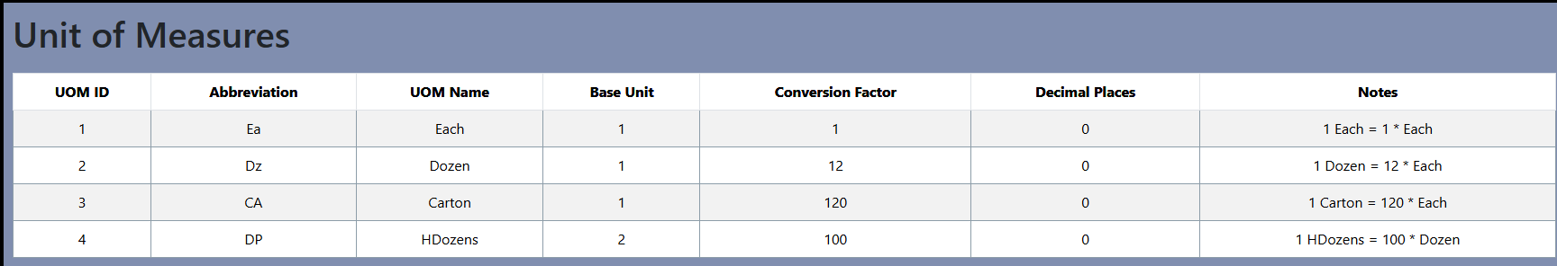
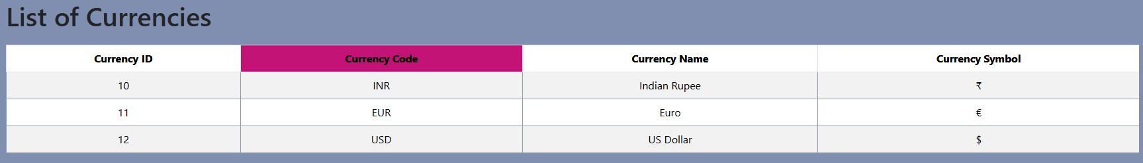
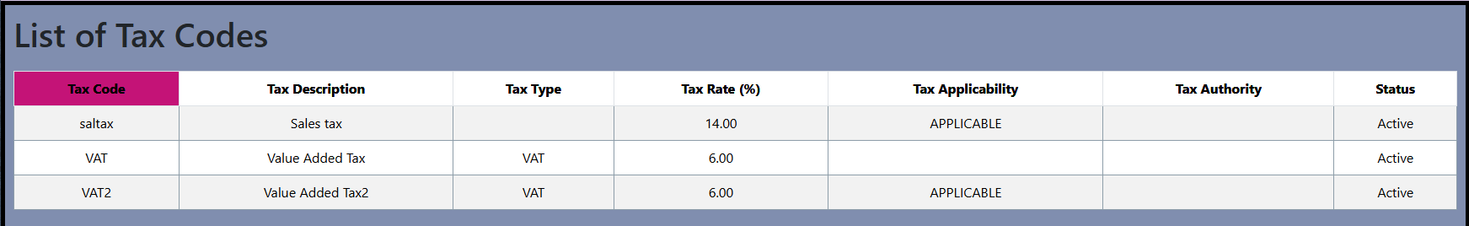
UOM, Currencies, Tax Codes
UOMs define the standard units used for measuring products. Currencies represent the monetary systems in which transactions are conducted. Tax codes, on the other hand, specify the applicable taxes for different goods or services
Create UOMs
Navigation : Modules >Common > UOM
Create Currencies
Navigation : Modules >Common >Currencies
Create Tax Codes
Navigation : Modules > Common > Tax Codes

Slide 8
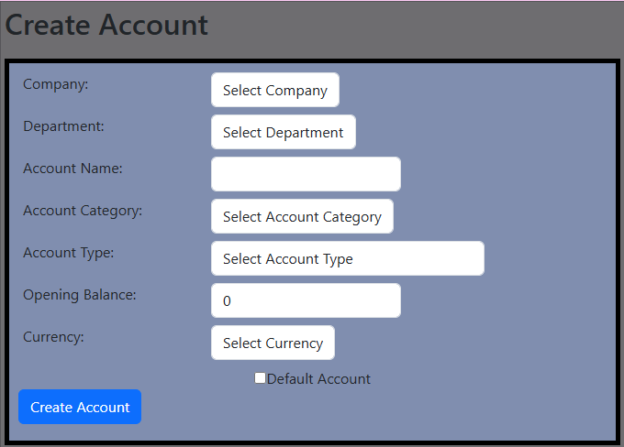
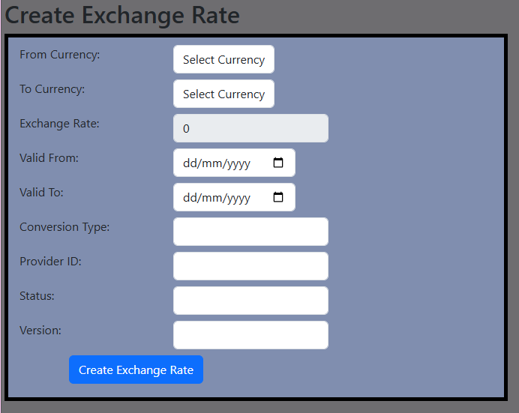
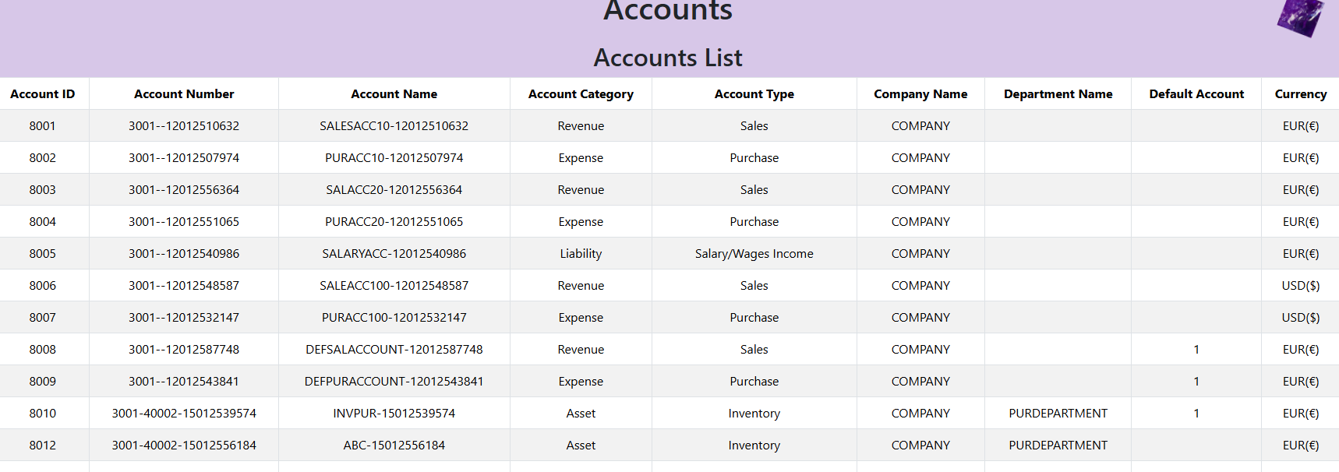
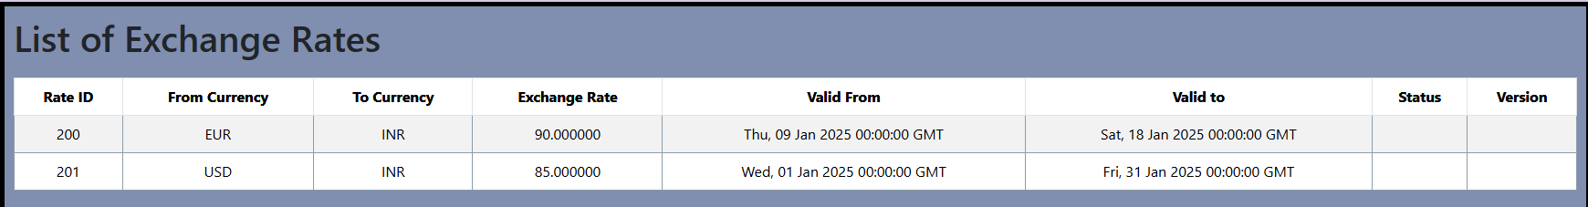
Accounts & Exchange rates
Accounts represent the financial records used by a business to track its income, expenses, assets, and liabilities, exchange rate management is vital for businesses involved in international trade
Create Accounts
Navigation : Modules >Finance> Accounts > Create Accounts
View Accounts
Navigation : Modules >Finance> Accounts >Get Accounts
Create Exchange Rates
Navigation : Modules > Common > Exchange Rates

Slide 9
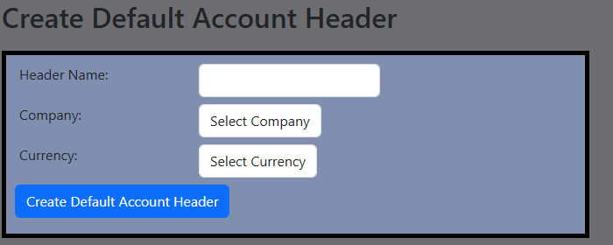
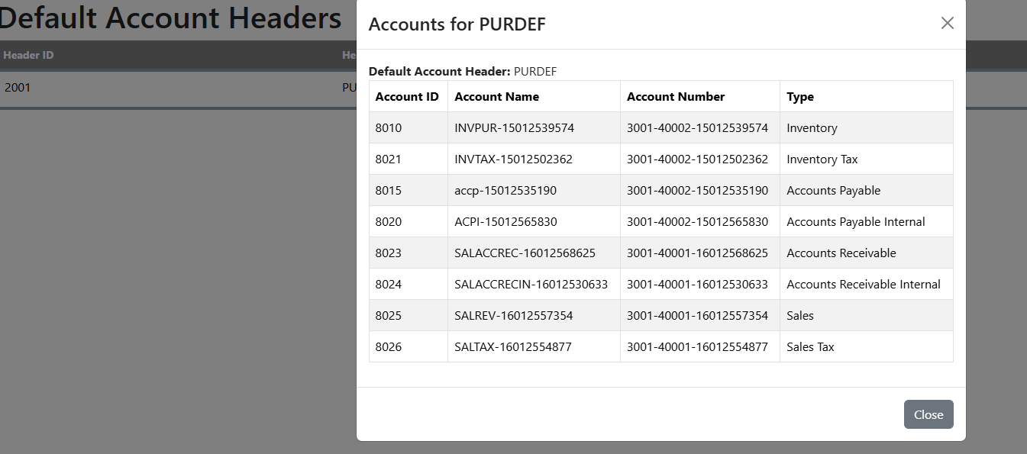
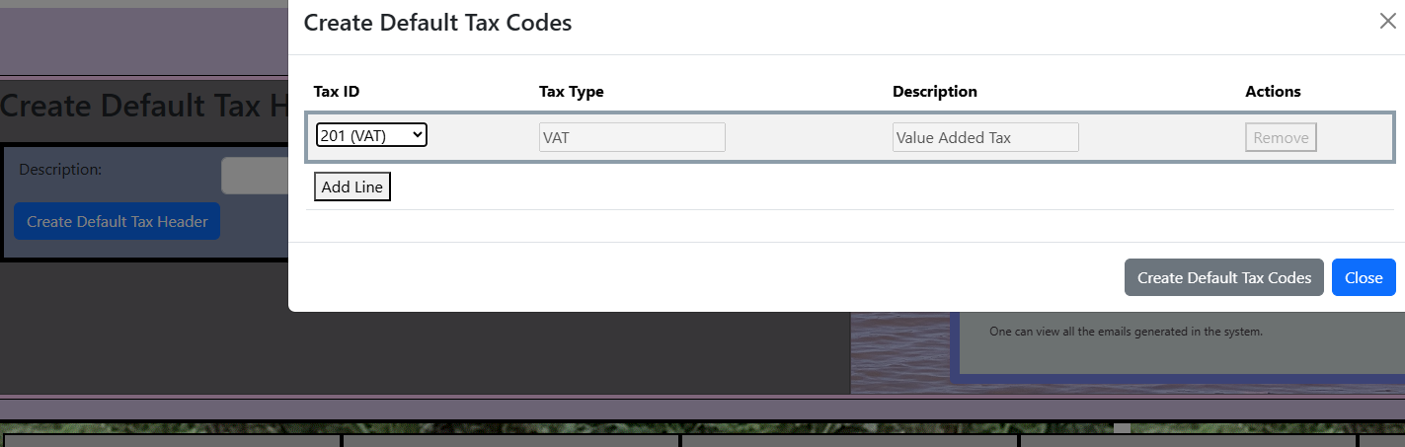
Default Accounts & Tax Codes
Default accounts and tax codes must be linked to departments or the company to enable the automatic processing of certain transactions, such as the auto-creation of invoices based on purchase or sales transactions
Create Default Account Heders
Navigation : Modules >Finance> Accounts > Create Accounts
Create Default Tax code headers
Navigation : Modules >Finance> Accounts >Get Accounts
Note : These default accounts / tax codes can be linked to company or departments or both

Slide 10
Master Data & Setups-2
Legal Entities
Group company
Companies
Departments

Slide 11
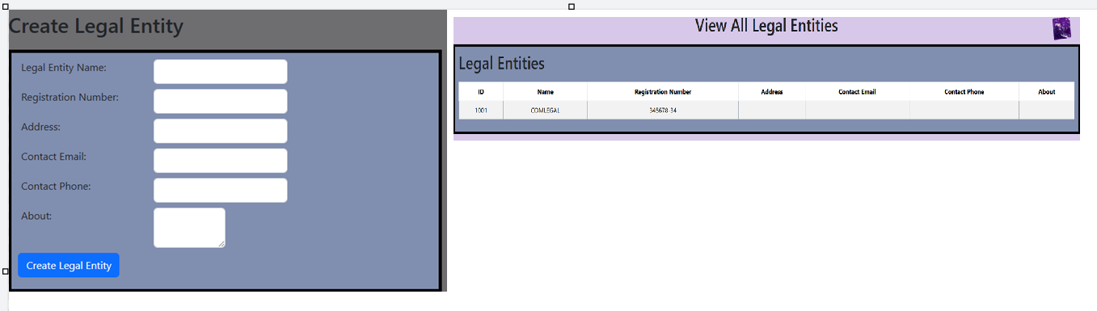
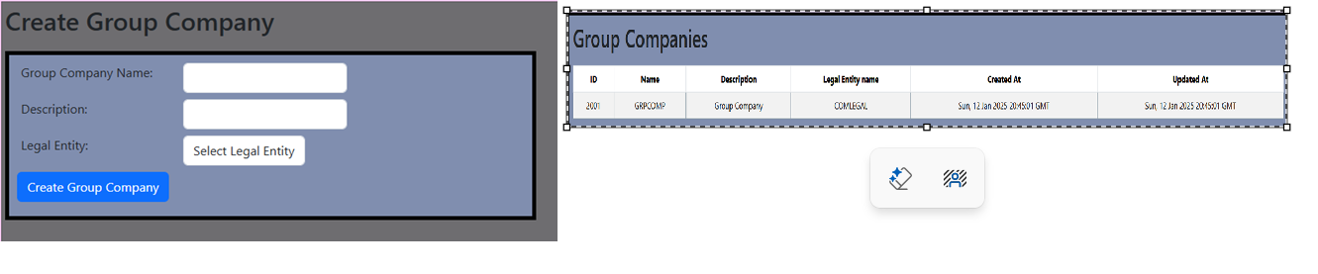
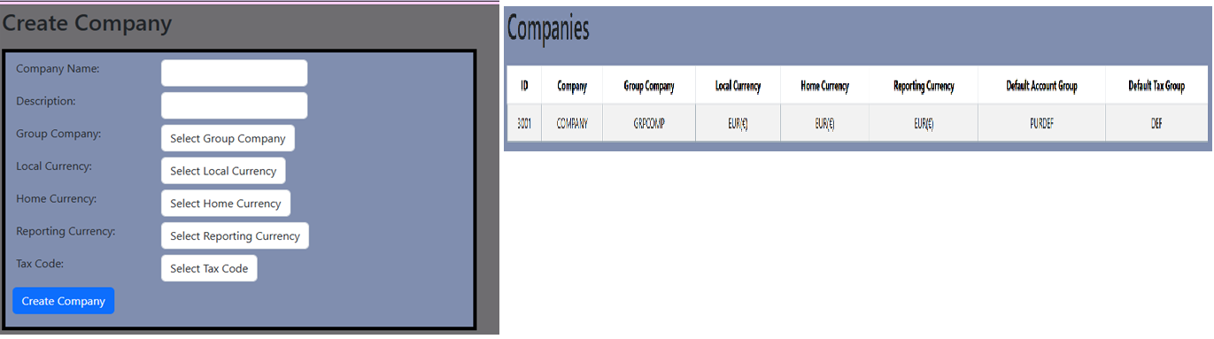
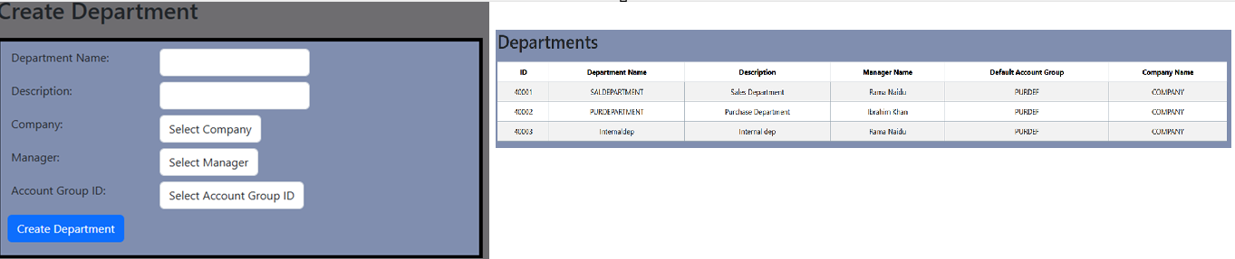
Legal Entities, Companies , Departments
Legal entities, group companies, companies, and departments are key organizational structures that help businesses manage operations and financial reporting effectively
Manage Legal Entity
Navigation : Modules >Common > Legal Entities
Manage Group Company
Navigation : Modules >Common >Group Companies
Manage Companies
Navigation : Modules > Common > Companies
Manage Departments
Navigation : Modules > Common > Departments

Slide 12
Master Data & Setups-3
Business Partners
Product Categories & Products
Bill of Materials & BOM Explosion

Slide 13
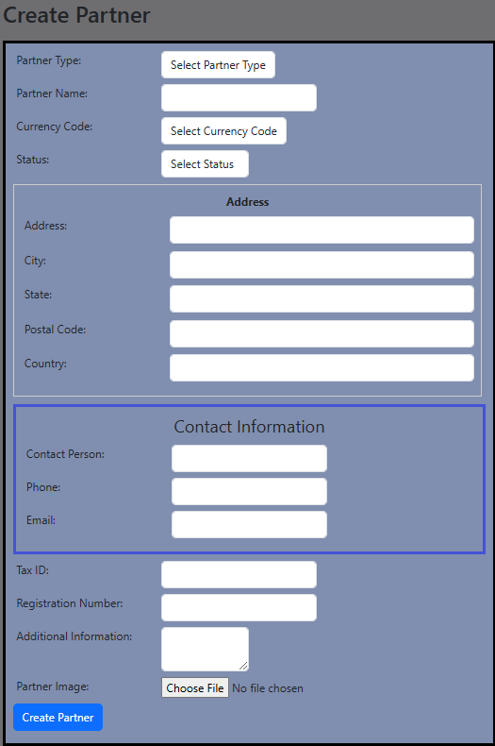
Business Partners
A business partner can be either a supplier, a customer, or both. As a supplier, the business partner provides goods, services, or resources to the company as a customer, the business partner purchases products or services from the company
Manage Business Partners
Navigation : Modules >Common > Business Partners
Select Type : Supplier or Customer or Both or Internal

Slide 14
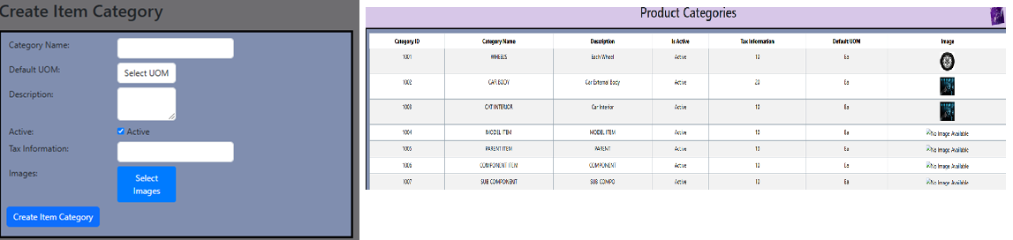
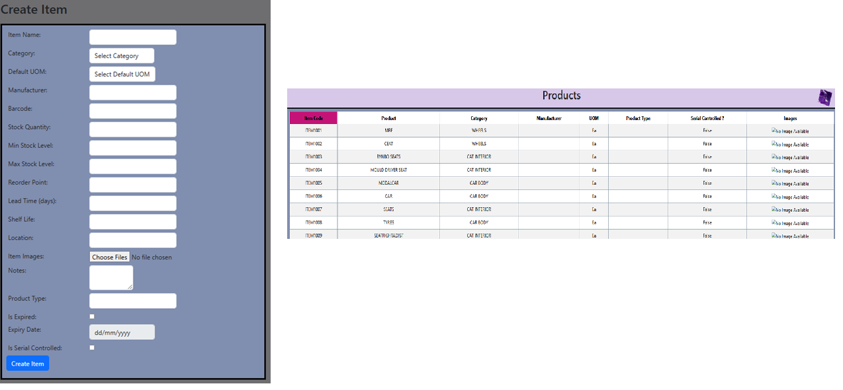
Product Categories & Products
Product categories are broad groups or classifications for example type, function, or target market
Products, on the other hand, are individual items or goods offered by a company
Manage Product categories
Navigation : Modules >Products > Product categories
Manage Products
Navigation : Modules >Products > Products

Slide 15
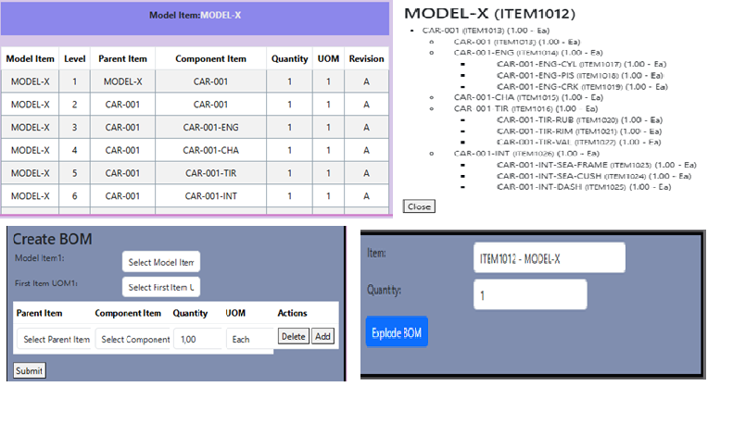
Bill of Materials
A Bill of Materials (BOM) is a comprehensive list of all the raw materials, components, sub-assemblies, and parts required for a Modal Item
Once the BOM is created for a Modal it can also be exploded to a desired quantity so an organization can get to know how much quantities it is required for components and sub components to assemble or to purchase
Manage Bill of Materials
Navigation : Modules >common > BOM
Note : While Bill of Materials (BOM) is primarily associated with manufacturing companies, it can also be useful in distribution businesses, such as sales and purchase companies, in certain scenarios
Track and manage the components that make up a bundle or kit.
Ensure that inventory levels are maintained for each individual product within the bundle.
Streamline the sales process by offering pre-defined bundles that can be sold as a single item.

Slide 16
Master Data & Setups-4
Manage Warehouses
Manage Locations
Manage Zones
Manage Aisles
Manage Rows
Manage Racks
Manage Bins

Slide 17
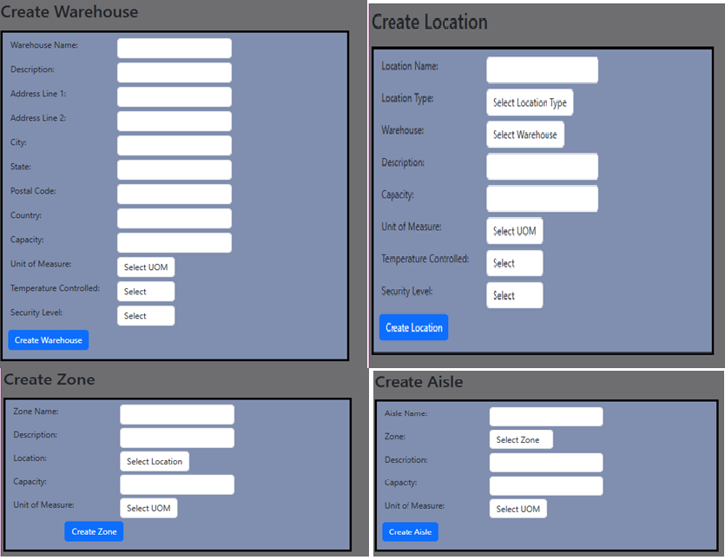
Inventory Storage units
Inventory storage units refer to the physical spaces or systems used to store and organize inventory in a warehouse, distribution center, or retail environment
Manage Warehouses
Navigation : Modules >Inventory > Warehouses
Manage Locations
Navigation : Modules >Inventory >Locations
Manage Zones
Navigation : Modules > Inventory > Zones
Manage Aisles
Navigation : Modules > Inventory > Aisles

Slide 18
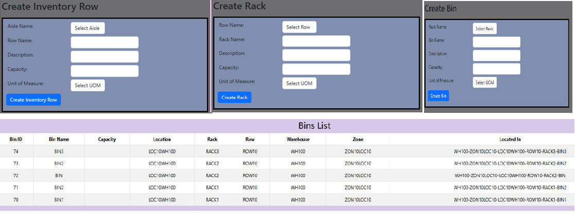
Inventory Storage units
Manage Rows
Navigation : Modules >Inventory > Rows
Manage Racks
Navigation : Modules >Inventory >Racks
Manage Bins
Navigation : Modules > Inventory >Bins

Slide 19
Transactions-Purchase
Purchase Order
Update & Approve Purchase Order
Purchase Order Receipts
Receipts & Inspections
Put Away

Slide 20

Purchase Order Transactions

Slide 21
PO Creation Steps
CREATING A PURCHASE ORDER
VIEWING THE PURCHASE ORDER
MODIFYING AND APPROVING
To create a Purchase Order, navigate to the Purchase module. Initiate the process and keep the PO in Draft status for initial review.
After creation, view the Purchase Order to note the specific number assigned. This number is crucial for tracking and reference.
Modify the draft Purchase Order as necessary. Once satisfied with the details, submit for approval, ensuring it meets company policies.

Slide 22
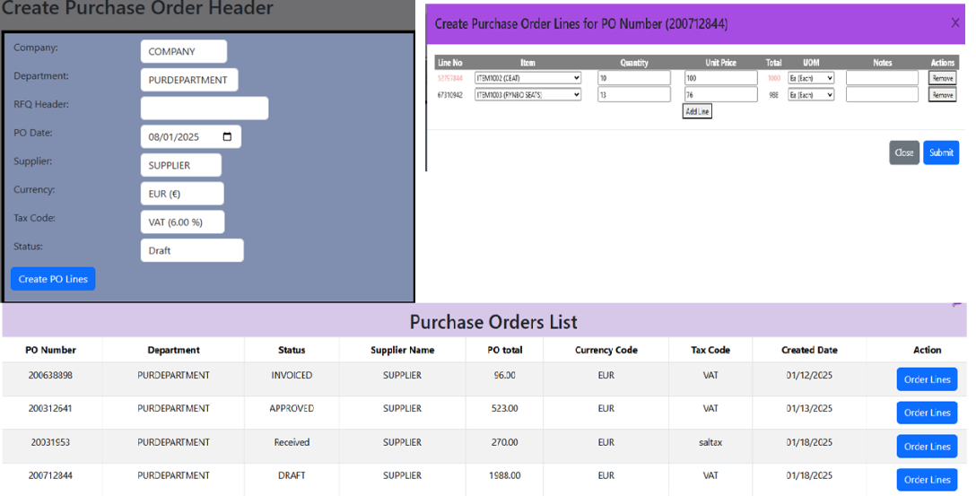
Purchase Order & Approval
Purchase Orders
Navigation : Modules >Purchase > Create PO
Modify & Approve
Navigation : Modules >Purchase > Modify PO
View Purchase Orders
Navigation : Modules > Purchase >View POs

Slide 23
Transactions-Sales
Sales Order & Approve
View Sales Orders
Pick Release

Slide 24
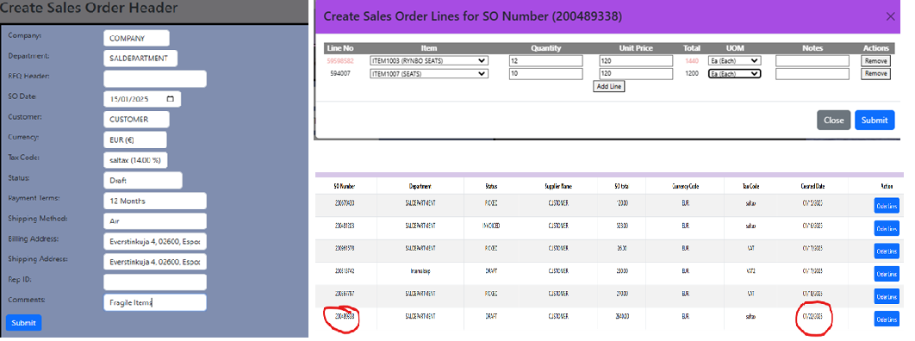
Sales Order & Approval
Sales Orders
Navigation : Modules >Sales> Create SO
Modify & Approve
Navigation : Modules >Sales> Modify SO
View Sales Orders
Navigation : Modules > Sales >View SOs

Slide 25
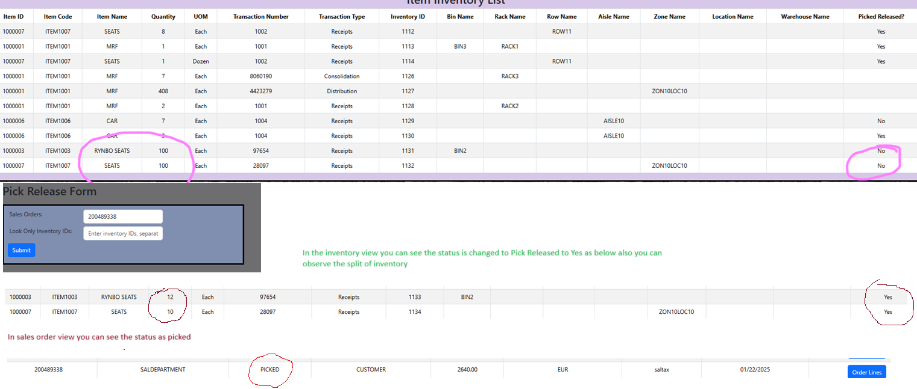
Pick Release
View Inventory
Navigation : Modules >Inventory> View Inventory
Navigation : Modules > Inventory > Search Inventory
Pick Release
Navigation : Modules >Inventory> Handling > Pick Release
View Sales Orders
Navigation : Modules > Sales >View SOs

Slide 26
Transactions-Invoices & Journal
Purchase Invoice
Sales Invoice
Journal Entries

Slide 27
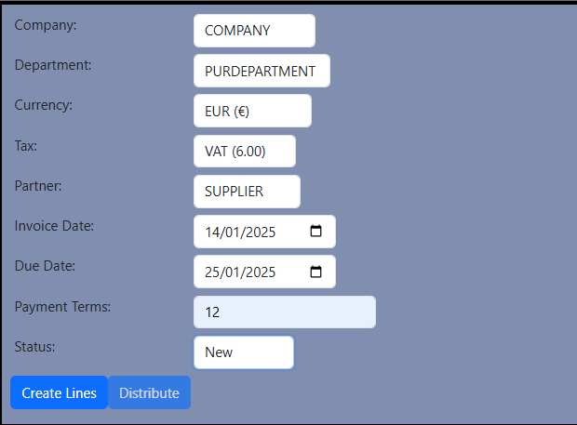
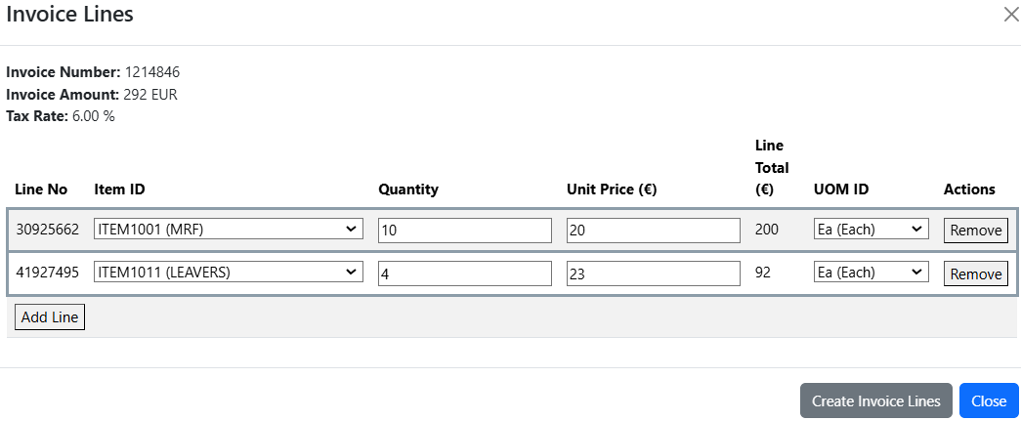
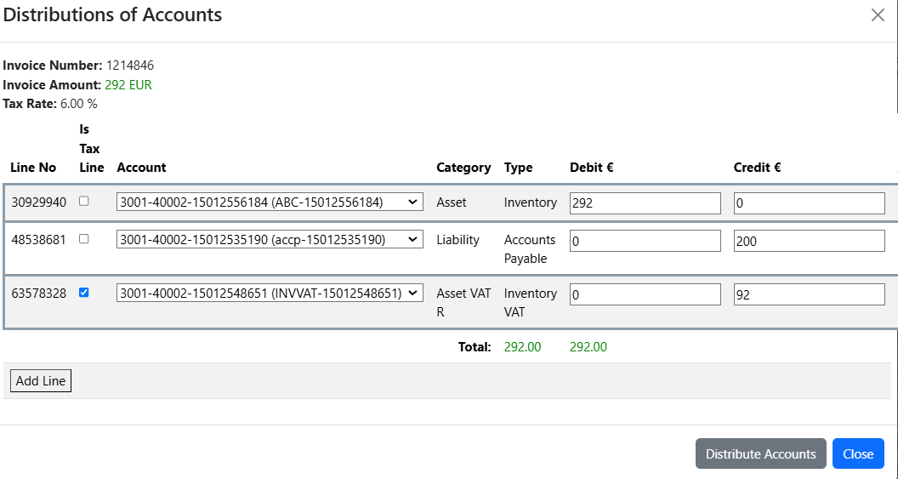
Purchase Invoice
Create Purchase Invoice
Navigation : Modules >Finance> Create Purchase Invoice
Update Purchase Invoice
Navigation : Modules >Finance> Update Purchase Invoice
View Purchase Invoices
Navigation : Modules >Finance> View Purchase Invoices

Slide 28
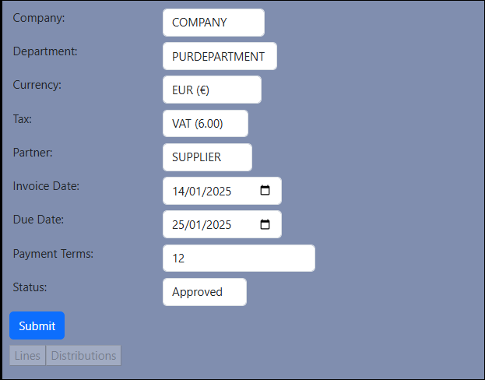
Update Invoice
Create Purchase Invoice
Navigation : Modules >Finance> Create Purchase Invoice
Update Purchase Invoice
Navigation : Modules >Finance> Update Purchase Invoice
View Purchase Invoices
Navigation : Modules >Finance> View Purchase Invoices

Slide 29
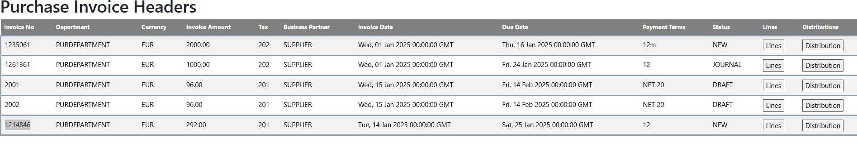
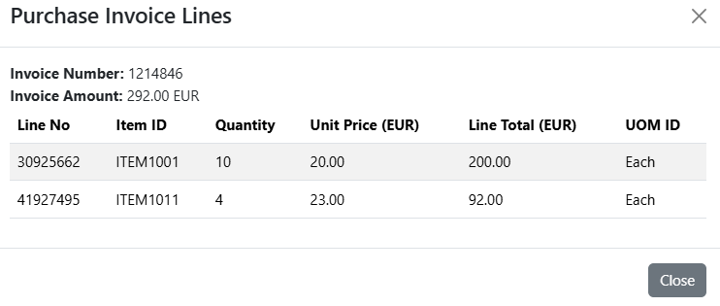
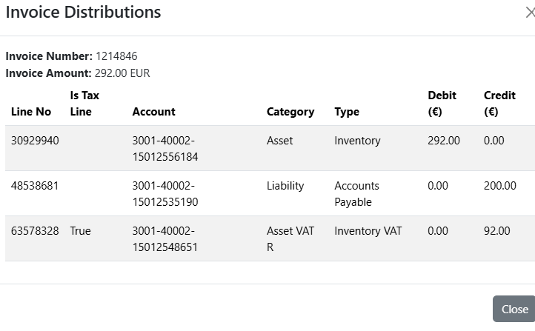
View Invoices
Create Purchase Invoice
Navigation : Modules >Finance> Create Purchase Invoice
Update Purchase Invoice
Navigation : Modules >Finance> Update Purchase Invoice
View Purchase Invoices
Navigation : Modules >Finance> View Purchase Invoices

Slide 30
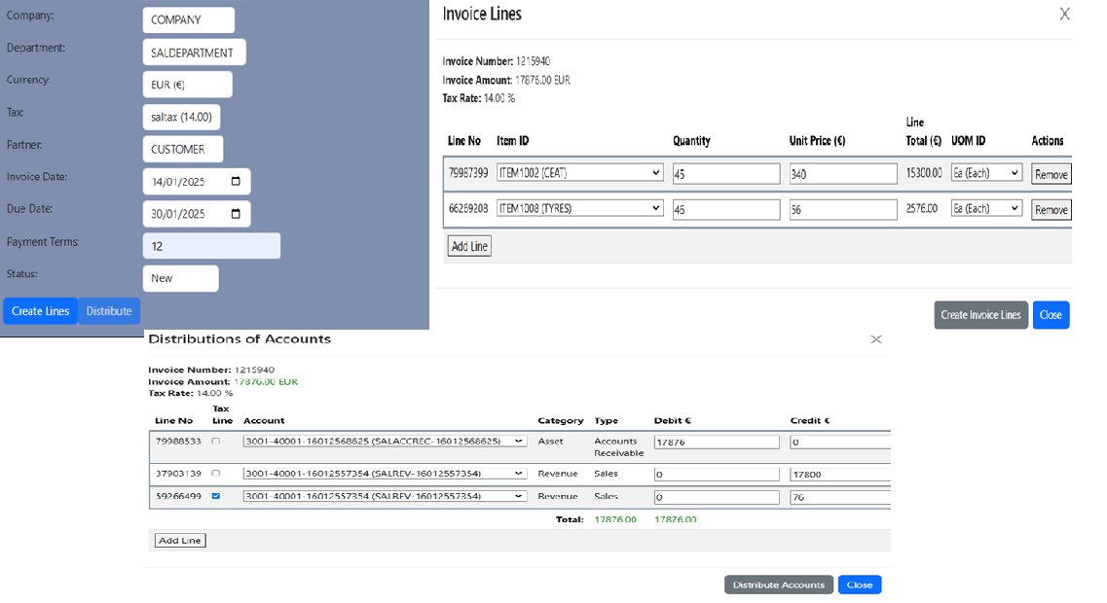
Sales Invoice
Create Sales Invoice
Navigation : Modules >Finance> Create Sales Invoice
Update Sales Invoice
Navigation : Modules >Finance> Update Sales Invoice
View Sales Invoices
Navigation : Modules >Finance> View Sales Invoices

Slide 31
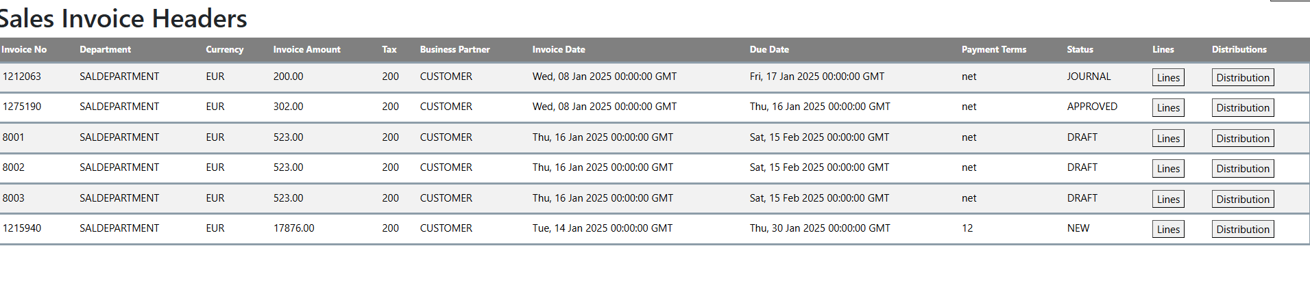
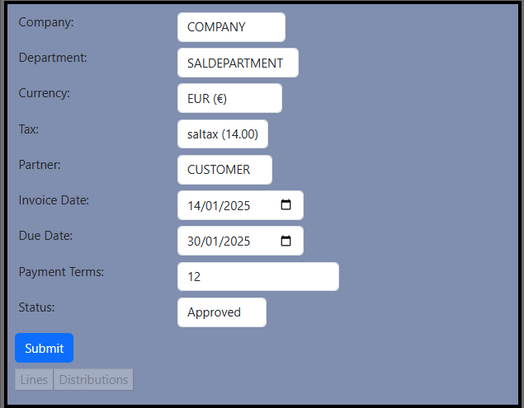
View , update sales invoices
Create Sales Invoice
Navigation : Modules >Finance> Create Sales Invoice
Update Sales Invoice
Navigation : Modules >Finance> Update Sales Invoice
View Sales Invoices
Navigation : Modules >Finance> View Sales Invoices

Slide 32
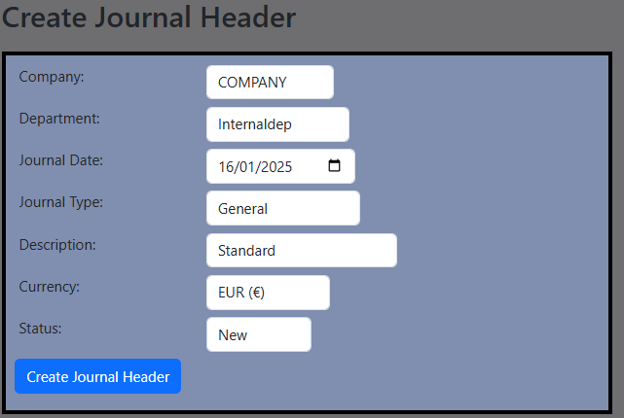
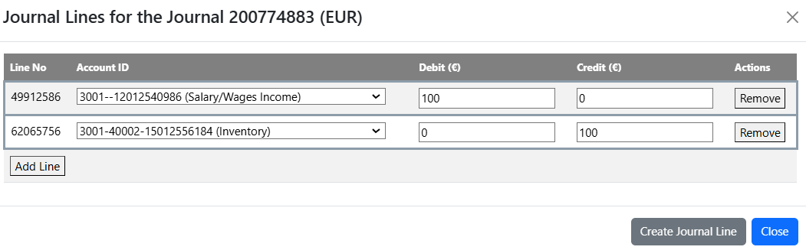
Journal Entries
Create Journal entries
Navigation : Modules >Finance> Create Journal
Update Journal entries
Navigation : Modules >Finance> Update Journal
View Journal entries
Navigation : Modules >Finance> View Journals

Slide 33
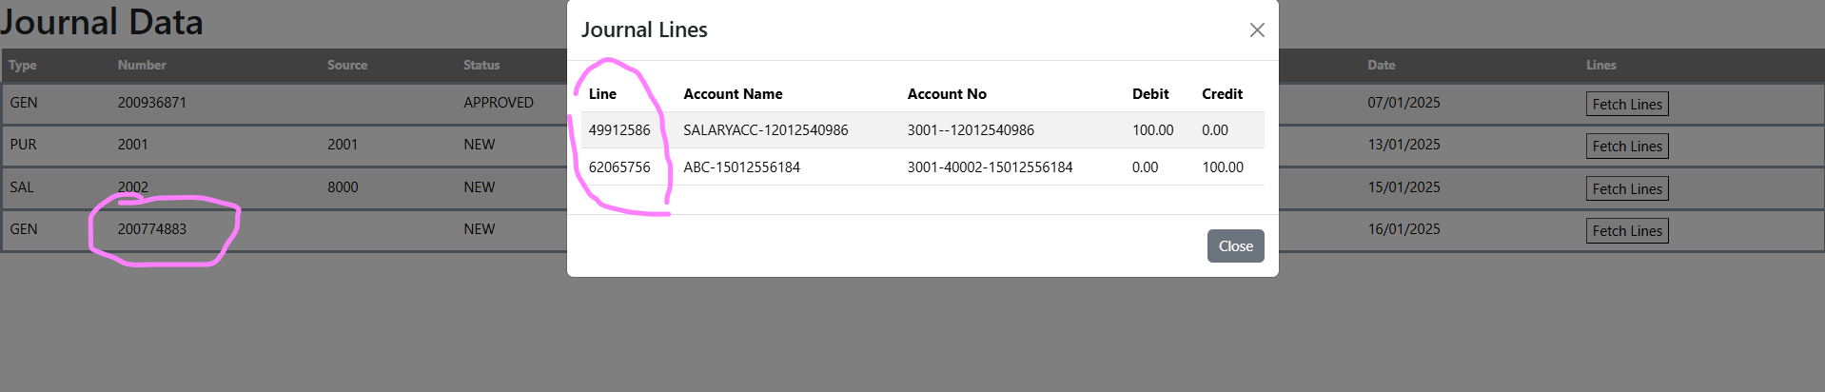
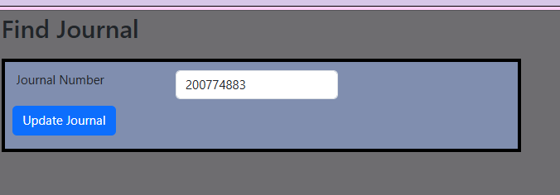
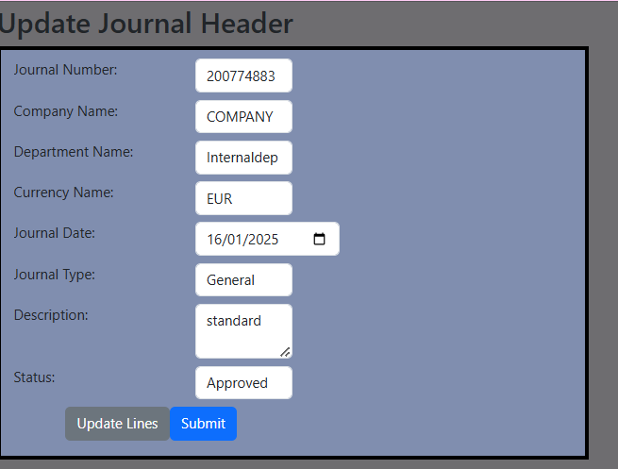
Journal Entries
Create Journal entries
Navigation : Modules >Finance> Create Journal
Update Journal entries
Navigation : Modules >Finance> Update Journal
View Journal entries
Navigation : Modules >Finance> View Journals

Slide 34
Transactions-Inventory
Item Consolidation by UOM
UOM conversion
Move Inventory

Slide 35
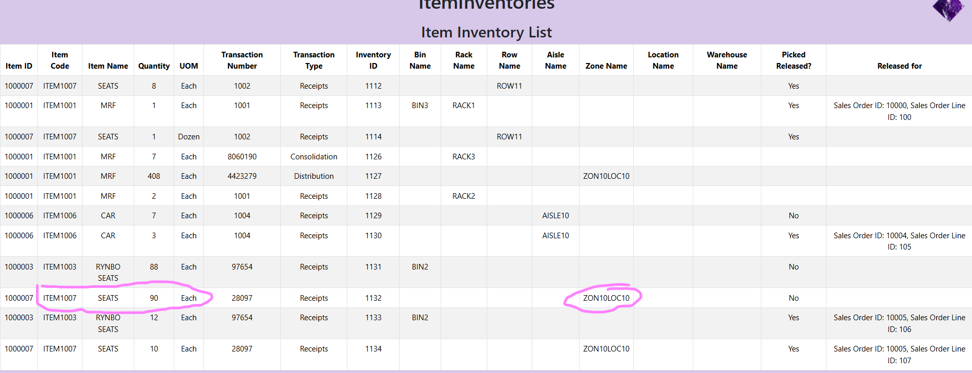
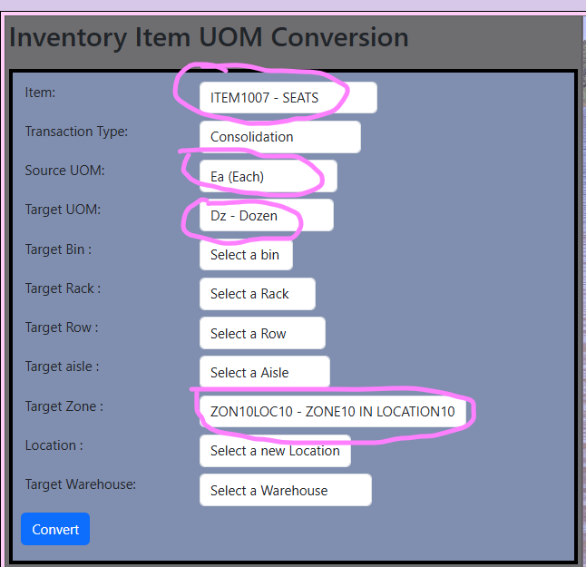
Item consolidation
Item consolidation
Navigation : Modules >Inventory> Handling >Item consolidation
Type : consolidation
Type Distribution
This will consolidate or distribute the inventory from one UOM to another UOM
You can change the quantity from Each to Dozens and vice versa

Slide 36
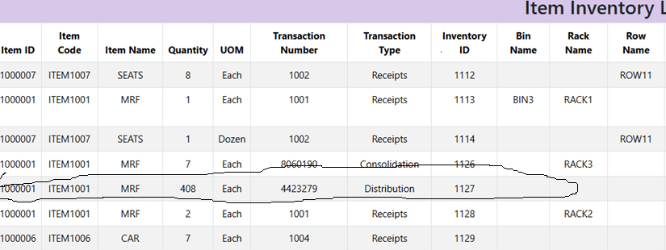
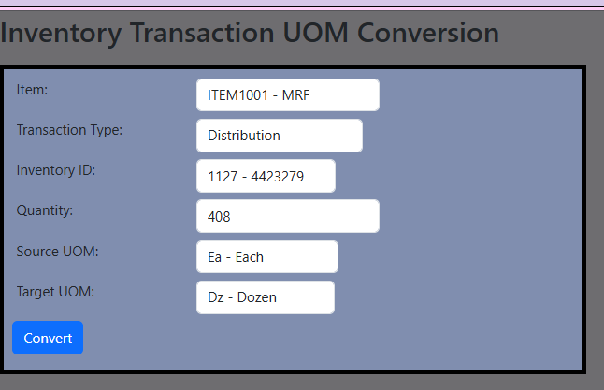

UOM conversion
UOM conversion
Navigation : Modules >Inventory> Handling >UOM conversion
Type : List all the available transaction types
This will convert the inventory from one UOM to another UOM
You can change the quantity from Each to Dozens to a particular transaction type of an inventory_id

Slide 37


Move Inventory
Move Inventory
Navigation : Modules >Inventory> Handling >Move Inventory

Slide 38
Transactions-Invoices & Journals
Create Purchase Invoice to a PO
Create Sales Invoice to a SO
Create a Journal to PI / SI

Slide 39



Invoices and Journals
Create Purchase Invoice
Navigation : Modules >Finance> Auto create Purchase Invoice
Create Sales Invoice
Navigation : Modules >Finance> Auto create Sales Invoice
Create Journal
Navigation : Modules >Finance> Auto create Journal

Slide 40
Questions

